Slide 1
Can you recognize the emotion from an image of a face?
Team: Section1-Group2
Team members: Chen, Qichao qc2254@columbia.edu
Culver, Ashley alc2221@columbia.edu
Lee, Richard rl3079@columbia.edu
Zhang, Justine yz3420@columbia.edu
Zheng, Kaiyan kz2324@columbia.edu

Slide 2
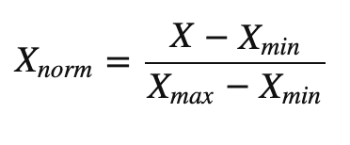
Preprocessing
Min-Max scaling
Changes the values of numeric columns in the dataset to a common scale
Does not distort differences in the ranges of values
Reduces sensitivity to magnitude
In logistic regression, each point will now contribute proportionately to the final distance
Provides speed up and accuracy
Logistic Regression
Accuracy: 0.502
Accuracy: 0.548
Feature Extract
keep two dimensional distance vector
(dx, dy) -> feature size (78-1)(78-2) /2 * 2
2) calcuate distance between points, choose uprigt triangle
sqrt(dx^2+dy^2) -> feature size (78-1)(78-2) /2
KNN
Accuracy: 0.28
Accuracy: 0.286

Slide 3
Baseline Model: KNN
Training dataset Accuracy: 0.4135
Testing dataset Accuracy: 0.324

Slide 4


Baseline Model: KNN
Simple and easy to implement.
There’s no need to build a model, tune several parameters, or make additional assumptions.
The algorithm is versatile. It can be used for classification, regression, and search (as we will see in the next section).
The algorithm gets significantly slower as the number of predictors increase.
Computationally expensive as it searches the nearest neighbors for the new point at the prediction stage, High memory requirement as KNN has to store all the data points.
Sensitive to outliers, accuracy is impacted by noise or irrelevant data.

Slide 5
Baseline Model: KNN + PCA
Time: 286 seconds
Accuracy: 28%
Time: 127 seconds
Accuracy: 28.6%

Slide 6
Parameter Tuning: GridSearchCV
https://cambridgecoding.wordpress.com/2016/04/03/scanning-hyperspace-how-to-tune-machine-learning-models/

Slide 7
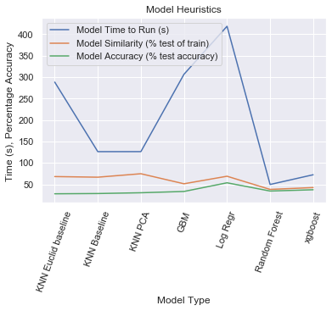
Logistic Regression – 56.2%
Random Forest -- 33.8%
GBM – 32.4%
XGBoost -- 40.0%

